Slide 1
Intox EC/IR II
Leonard R. Stamm
Goldstein & Stamm, P.A. 6301 Ivy Lane, Suite 504 Greenbelt, Maryland 20770 301-345-0122 (fax) 301-441-4652 stamm.lenny@gmail.com
www.lstamm.com
Mastering Scientific Evidence in DUI Cases
National College for DUI Defense and Texas Criminal Defense Lawyers Association
New Orleans, LA
March 23, 2012

Slide 2
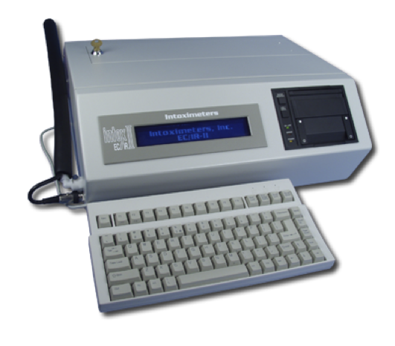
Intox EC/IR II

Slide 3
Breath test history – some past/present issues
Partition ratio
Temperature
Rising BAC
Hematocrit
New paradigm – Dr. Hlastala
Mouth alcohol
Belching
Regurgitating
GERD

Slide 4
Breath test history – some past/present issues
20 minutes observation
Disconnect
Hiding the manufacturer of alcohol reference solutions
Throwing out chromatograms of solution tests
Throwing out initial certification records of Intox 3000
Failing to identify technician who tested EC/IR during certification testing
Failing to test solutions used during certification testing

Slide 5
Breath test history – some past/present issues
Discovery violations
Failure to comply with subpoena
Destruction of evidence
Backdating certification certificates
Failure to properly test simulator thermometer – traceable to NIST
Operator FTAs
Using calibration gas as validation gas

Slide 6
Maryland’s program
Foundation –
Casper v. State, 70 Md. App. 576, 521 A.2d 1281 (1987)
Operator certified
Test within 2 hours of apprehension
Equipment approved by the toxicologist – Courts & Judicial Proceedings Article § 10-304(b)

Slide 7
Equipment approved by the toxicologist – Courts & Judicial Proceedings Article § 10-304(b)
Approval is prima facie proof of accuracy and reliability - Casper
Evidence showing unreliability may shift the burden of proving reliability back to the State and if not met – test may be excluded - Casper
May be proved by a certificate signed by the toxicologist without the toxicologist appearing in court
Certificate is prima facie proof of approval

Slide 8
Certificates violate Confrontation Clause
Melendez-Diaz v. Massachusetts
Bullcoming v. New Mexico
Certificate is a testimonial statement
Certificates are affidavits

Slide 10
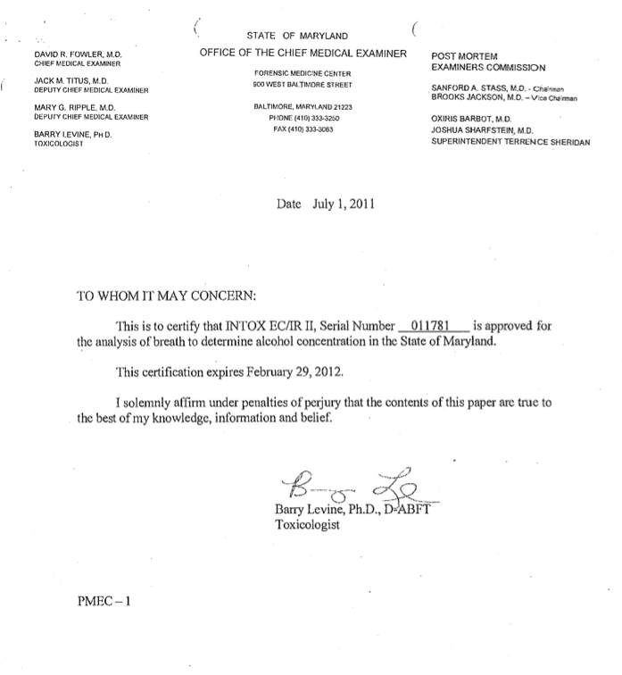

Slide 11
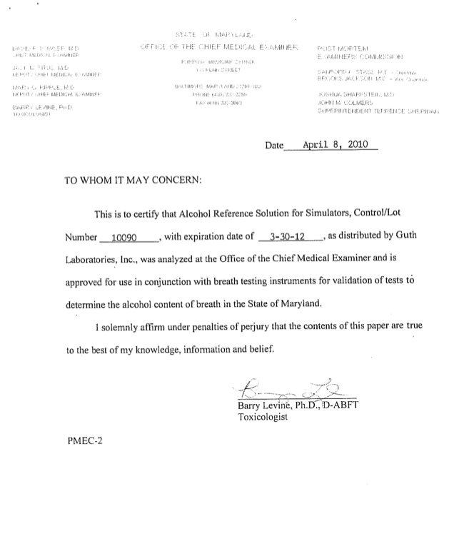

Slide 12
Requirements for Authenticity
Maryland Rule 5-1005 –
A copy must be certified as a business record
Maryland Rule 5-902
Bus. rec. without custodian - 10 days notice
Business record
(A) was made, at or near the time of the occurrence of the matters set forth, by (or from information transmitted by) a person with knowledge of those matters, (B) is made and kept in the course of the regularly conducted business activity, and (C) was made and kept by the regularly conducted business activity as a regular practice

Slide 13
Requirements for Authenticity
State v. Bryant, 761 A.2d 925, 361 Md. 420 (2000) – “This is to certify that the enclosed medical records are an accurate reproduction of the medical records pertaining to patient WILLIAM BRYANT, which are created and kept during the normal course of business. These records are housed in the Medical Record Services Department of the University of Maryland Medical System from the time of patient discharge or release. Both inpatient and outpatient records are housed in one medical record. To the best of my knowledge, these are the complete medical records of this patient.”

Slide 14
Requirements for Authenticity
State v. Bryant, 761 A.2d 925, 361 Md. 420 (2000) – “Nonetheless, Dr. Levine never testified that the report was made at or near the time of the tests or that it was made by a person with knowledge, as Rule 5-803(b)(6) requires. Therefore, his testimony also was inadequate to establish the necessary evidentiary foundation to admit the toxicology report.”

Slide 15
Courts & Judicial Proceedings Article, § 10-204
Certified copies of public records admissible
(a) A copy of a public record, book, paper, or proceeding of any agency of the government of the United States, the District of Columbia, any territory or possession of the United States, or of any state or of any of its political subdivisions or of an agency of any political subdivision shall be received in evidence in any court if certified as a true copy by the custodian of the record, book, paper, or proceeding, and if otherwise admissible.

Slide 16
Courts & Judicial Proceedings Article, § 10-204
Contents of certification
(c) A certification under this section shall include: (1) The signature and title of the custodian or other person authorized to make the certification; (2) The official seal, if any, of the office; and (3) A statement certifying that the copy is a true copy of the public record.

Slide 17
But can the prima facie evidence of approval be rebutted?
Code of Maryland Regulations requirements for approval of EC/IR II
E. Initial Certification of Instrument Approval.
(1) Precision and Accuracy Testing.
(a) Vapor containing 0.020 g/210L, 0.040 g/210L, 0.080 g/210L, and 0.160 g/210L ethanol concentrations shall be introduced through the breath tube of the instrument.
(b) Each concentration shall be repeated 4 times.

Slide 18
But can the prima facie evidence of approval be rebutted?
(c) As an indication of precision, the combined average standard deviation shall be not greater than 0.0042 g/210L.
(d) As an indication of accuracy, systematic variations at each ethanol concentration will be calculated and shall be not more than 5 percent or 0.005 g/210L, whichever is greater.
(e) An instrument not meeting the precision and accuracy requirements may not be approved.

Slide 19
But can the prima facie evidence of approval be rebutted?
(2) Acetone Detection Testing.
(a) Vapor containing 0.020 g/210L ethanol and 100 microliters of acetone per 500 mL solution shall be introduced through the breath tube of the instrument.
(b) Each concentration shall be repeated 4 times.
(c) The instrument shall read between 0.015 and 0.025 g/210L.
(d) An instrument not meeting the requirement for acetone detection may not be approved.

Slide 20
But can the prima facie evidence of approval be rebutted?
(3) Blank Testing.
(a) Four samples of vapor containing no ethanol or other solvents shall be introduced through the breath tube of the instrument.
(b) No reading shall exceed 0.005 g/210L vapor.
(c) An instrument not meeting the blank detection requirement may not be approved.
(4) If conditions outlined in §E(1)—(3) are met:
(a) The instrument shall be approved; and
(b) The Toxicologist shall issue a letter certifying instrument approval.

Slide 21
But can the prima facie evidence of approval be rebutted?
Code of Maryland Regulations requirements for controls – only approval

Slide 22
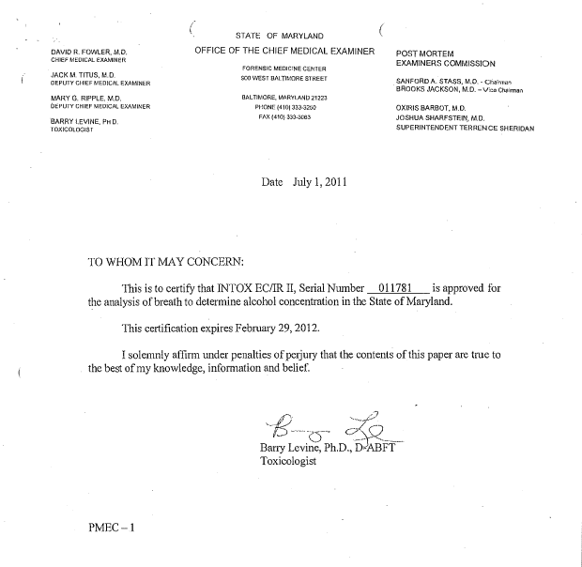
What discovery revealed

Slide 23
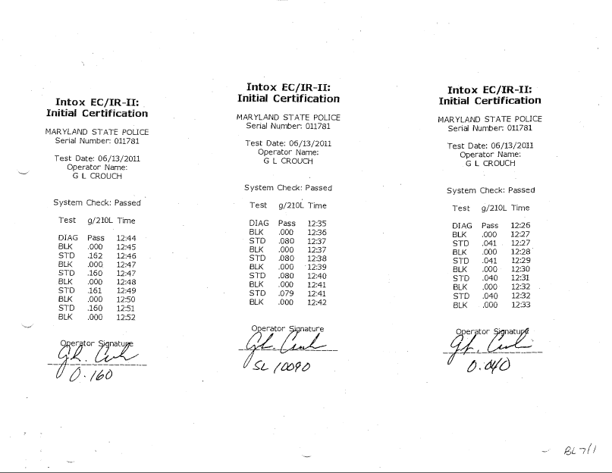
What discovery revealed

Slide 24
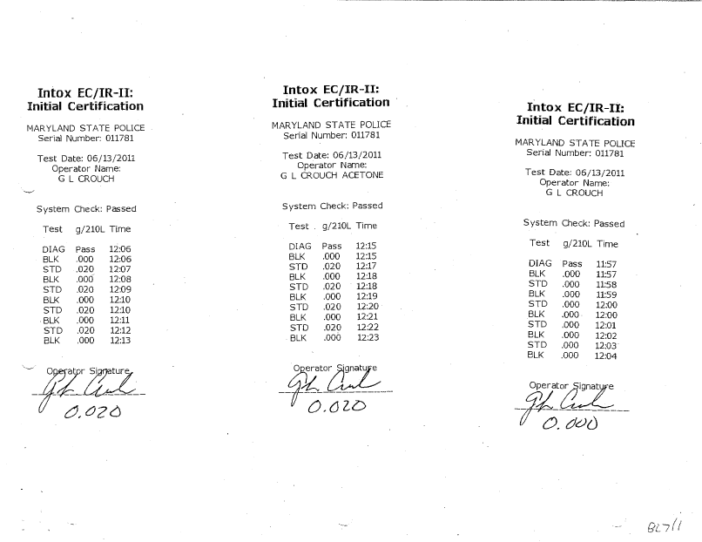
What discovery revealed

Slide 25
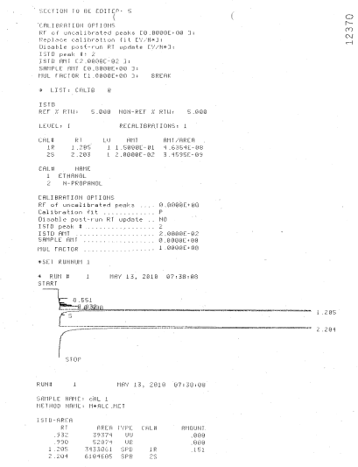

Slide 26
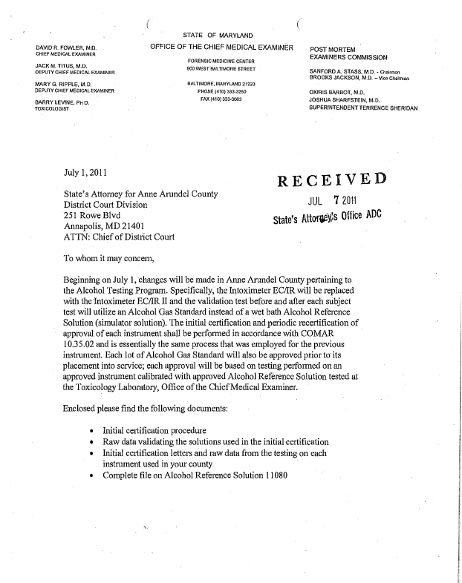
What discovery revealed

Slide 27
Case EC/IR II
Calibration
Alcohol Reference Solution
Certification
Alcohol Reference Solutions

Slide 28
Alcohol Gas Standard
EC/IR II
Calibration
Alcohol Reference Solution
Certification
Alcohol Reference Solutions

Slide 29
Case EC/IR II Alcohol Gas Standard
Calibration
Alcohol Reference Solution
EC/IR II
Calibration
Alcohol Reference Solution
Certification
Alcohol Reference Solutions
Certification
Alcohol Reference Solutions

Slide 30
Case EC/IR II Alcohol Gas Standard
Calibration
Alcohol Reference Solution
EC/IR II
Certification
Alcohol Reference Solutions

Slide 31
If approvals are accepted, can prima facie reliability be rebutted?
Discovery issues
Source code
Manual provision
IntoxNet reports
Factual issues
Source code
Manual compliance
IntoxNet reports
20 minute observation period
GERD

Slide 32
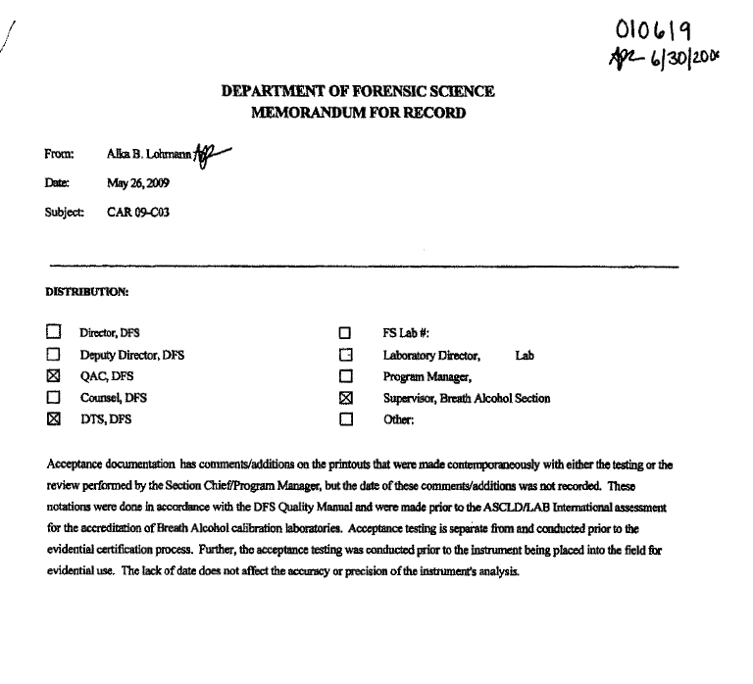
Virginia

Slide 33
Virginia

Slide 34
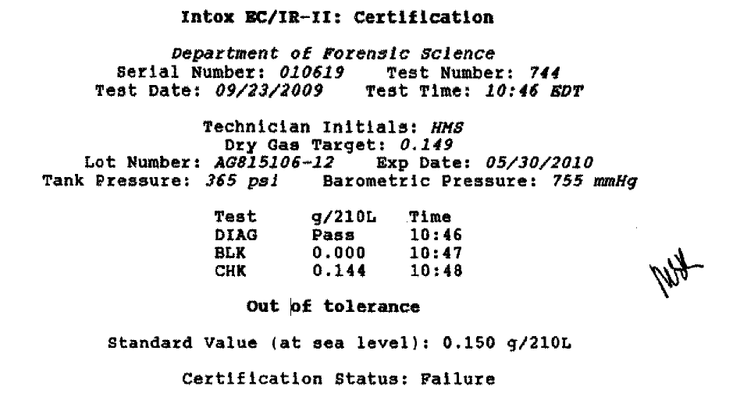
Virginia

Slide 35
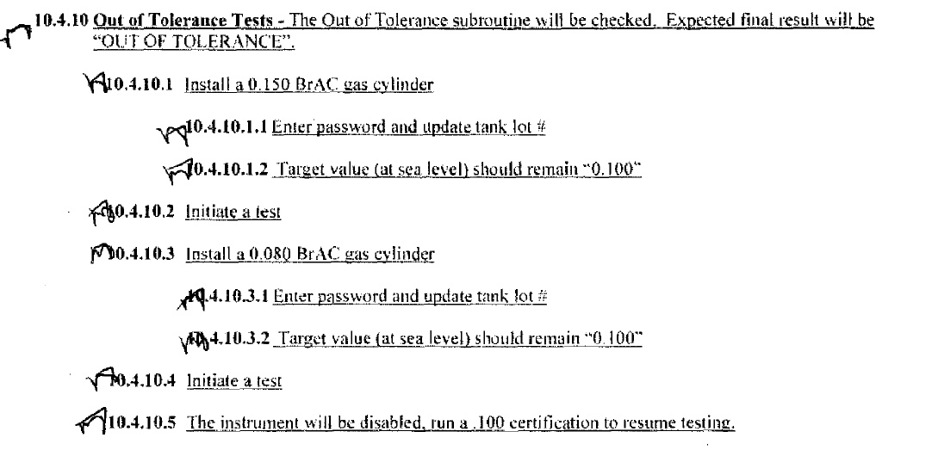
Virginia

Slide 36
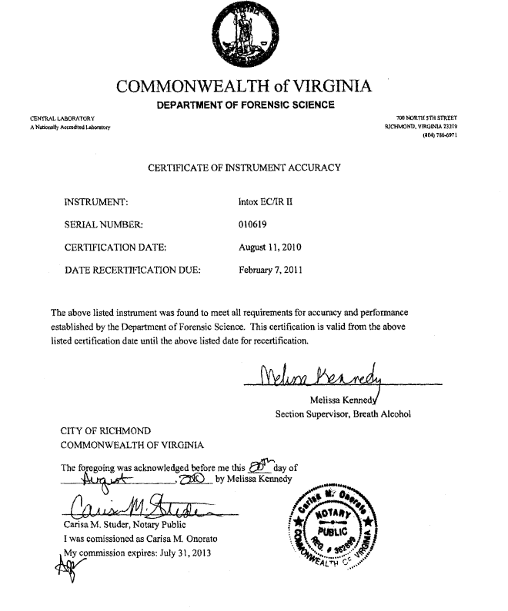
Virginia

Slide 37
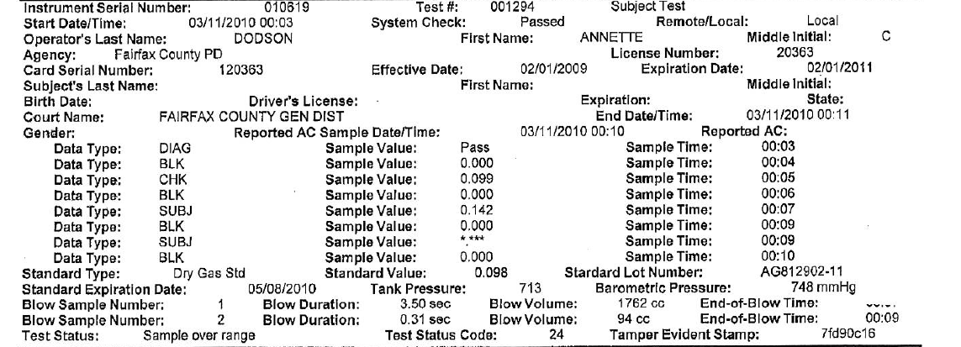
Virginia

Slide 38
The end!
Leonard R. Stamm
Goldstein & Stamm, P.A.
6301 Ivy Lane, Suite 504
Greenbelt, Maryland 20770
301-345-0122
(fax) 301-441-4652
lstamm@lstamm.com
www.lstamm.com

