Slide 1
Applying SFST Science in the Courtroom
Leonard R. Stamm
Goldstein & Stamm, P.A. 6301 Ivy Lane, Suite 504 Greenbelt, Maryland 20770 301-345-0122 (fax) 301-441-4652 lstamm@lstamm.com www.thecrimestoppers.com/mse2012
Mastering Scientific Evidence in DUI Cases
National College for DUI Defense and Texas Criminal Defense Lawyers Association
New Orleans, LA
March 23, 2012

Slide 3
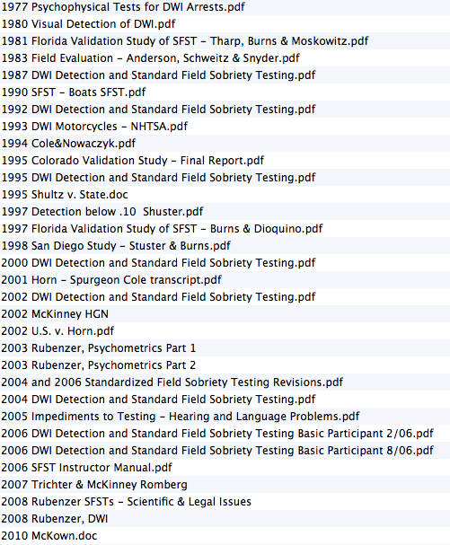

Slide 4
United States v. Horn, 185 F.Supp.2d 530 (D.Md. 2002)
SFSTs flunk Daubert
peer reviewed does not mean cops
can’t say “test”
can’t say “clues”
can’t say “passed” or “failed”
cannot base opinion on SFSTs
can be used for probable cause

Slide 5
United States v. Horn, 185 F.Supp.2d 530 (D.Md. 2002)
Rule 702 must always be satisfied, whether the procedure is novel or not
Rule 702. Testimony by Expert Witnesses
A witness who is qualified as an expert by knowledge, skill, experience, training, or education may testify in the form of an opinion or otherwise if:
(a) the expert’s scientific, technical, or other specialized knowledge will help the trier of fact to understand the evidence or to determine a fact in issue;
(b) the testimony is based on sufficient facts or data;
(c) the testimony is the product of reliable principles and methods; and
(d) the expert has reliably applied the principles and methods to the facts of the case.

Slide 6
NHTSA CLAIMS
Accuracy > .10 1977, 1981, 1983
HGN - 77%
W&T - 68%
OLS - 65%
W&T AND HGN - 80%
More recent studies
Colorado - 1995 - > .05 - 93%
Florida - 1997 - > .08 - 95%
San Diego - 1998 - > .08 - 91%

Slide 7
Dr. Cole’s key points
1977
47% false impaired - .10 standard.
1981
32% false impaired - .10 standard.
Unfamiliarity can cause failure

Slide 8
Dr. Cole’s key points
“There has never been a single study done in which they tried to relate field sobriety tests to impairment”
Criticism of NHTSA Studies
Latest 3 studies - done wrong
San Diego, Colorado, Florida field studies
Should have 50% SFSTs and 50% no SFSTs
Baseline was 79%

Slide 9
Dr. Cole’s key points
Test-Retest Reliabilities - same people - later (1981)
Same officers
HGN - 66%
W&T - 72%
OLS - 61%
Different officers
HGN - 59 %
W&T - 34%
OLS - 60%
BAC measurement was .97 and .96 reliable

Slide 10
Dr. Cole’s key points
Different officers - same person and time (1981)
Different officers
HGN - 62%
W&T - 74%
OLS - 70%

Slide 11
Dr. Cole’s key points
Percentage of Subjects Classified as Arrested or Impaired at each alcohol dose (1981)
18% of placebo (.00) subjects
31% of .05 subjects
Correlation between machine angle of nystagmus onset and individual rater estimates of onset (1981)
Average .58

Slide 12
Key points in Dr. Cole’s testimony in the transcript
No norms OLS
e.g. 20 year old v. 40 year old
Dr. Cole’s study (W&T and OLS)
none of subjects had alcohol
47% of subjects classified as too impaired to drive by police
normal tasks v. abnormal tasks
normal tasks had a lower error rate
“My argument with her [Marcelline Burns] is the . . . heel-to-toe and one-leg-stand are too sensitive.”

Slide 13
Rubenzer - 2003
Critique of field studies – Fla., Colo., San Diego
Not really “experiments” bc no controls
Studies validated arrest decisions – not SFSTs – bc officers had other info (e.g. driving, odor, appearance)
San Diego used PBTs in arrest decision
Colo. and Fla. officers were supervised
Insufficient documentation
No inter-rater reliability

Slide 14
Rubenzer - 2003
Critique of field studies – Fla., Colo., San Diego
No inter-rater reliability
No discussion of weaknesses of studies
None peer reviewed
Problems with 1981 laboratory study
subjects had no reason to fear detection/arrest;
testing was conducted during the day rather than night, when most DWIs occur;
officers were able to observe, talk to, and smell the subjects;

Slide 15
Rubenzer - 2003
For the NHTSA study, subjects were recruited from the state employment office and are not representative of the general population, and no attempt was made to justify this source as representative of DWI stoppees; and
The same subjects were used to create the cutoff scores for the test and to evaluate the accuracy of these cutoff scores

Slide 16
Rubenzer - 2003
Standardization problems
Screening for medical problems not standardized
Standardized instructions have changed
Instructions not always delivered the same
No instructions re: attitude, speed, & tone
W & T line variations
What demonstrates understanding?
Scoring not totally clear – e.g. improper turn
What counts as failing if passes one or more

Slide 17
Rubenzer - 2003
No requirement officers record observations immediately
Reliabilty and validity problems
Not double blind
The effects of fatigue, drowsiness, circadian rhythm, driver stiffness or roadside conditions on SFST performance have not been adequately investigated
What is affect of fear, anxiety or stress
W&T & OLS – no data on individual clues

Slide 18
Rubenzer - 2003
No standard error measurement
No large number of tests on sober people – no “normal” score
Very little data <21 or >55
Effect of age, physical condition, degree of overweight not known
80% best case does not = proof beyond a reasonable doubt

Slide 19
Rubenzer - 2003
Miscellaneous issues
NHTSA researchers – not independent
High base rate – up to 92% legally intoxicated
Scoring potentially biased
SFSTs do not = driving
SFSTs never validated for impairment – but used that way
HGN more prejudicial > probative on impairment

Slide 20
Rubenzer – 2008 HGN
The NHTSA-recommended speed for breakdown of smooth pursuit (SP) may be very close to the maximum pursuit velocity without visible saccades for many people when sober, even under favorable conditions
According to the largest study of its kind, about 10 percent of people have onset of nystagmus before 45 degrees of lateral deviation of the eyes at 0.00 percent BAC; another 10 percent have onset of nystagmus at 45 degrees.

Slide 21
Rubenzer – 2008 HGN
HGN affected by age
HGN is sort of divided attention
I.e. mental distractions can cause lack of smooth pursuit
Background characteristics can interfere
Many more medical causes of LSP than listed in Schultz
Some psychiatric conditions can cause LSP
Nicotine can cause LSP

Slide 22
Rubenzer – 2008 HGN
Nystagmus probably not affect vision acuity
Inter-rater and test-retest reliability – 50-70% is too low

Slide 23
Steven J. Rubenzer, 32 Law & Hum. Behav. 293, The Standardized Field Sobriety Tests: A Review Of Scientific And Legal Issues (August, 2008)
Reviews everything ever written
Scant reporting of subject variables
Almost never double blind
No study to date has used mental, behavioral, or driving impairment as the SFST's criterion

Slide 24
Steven J. Rubenzer, 32 Law & Hum. Behav. 293, The Standardized Field Sobriety Tests: A Review Of Scientific And Legal Issues (August, 2008)
Conclusions
There are serious deficiencies in the research that supports the SFSTs. The fundamental question of validity has not been addressed rigorously, nor have the effects of many common, potentially confounding variables likely to be present at many DWI stops been examined.

Slide 25
Steven J. Rubenzer, 32 Law & Hum. Behav. 293, The Standardized Field Sobriety Tests: A Review Of Scientific And Legal Issues (August, 2008)
Research is long overdue to:
Determine the validity of the SFSTs for predicting BAC under rigorous, double blind conditions.
Determine whether the SFSTs are related to driving ability or measures of mental, physical, or visual impairment using double blind studies. If so, to what degree? If not, identify the tests as they are.

Slide 26
Steven J. Rubenzer, 32 Law & Hum. Behav. 293, The Standardized Field Sobriety Tests: A Review Of Scientific And Legal Issues (August, 2008)
Investigate the effects of age, gender, physical infirmity, sleepiness, fatigue, time of day, and anxiety/fear of evaluation on performance on the SFSTs, both in conjunction with alcohol consumption and in sober subjects. Norms based on large, representative samples, broken down by relevant factors, should be developed.

Slide 27
SFSTs - HGN
Schultz v. State, 106 Md.App. 145, 664 A.2d 60 (1995)
Officer properly trained and certified
HGN shows presence of alcohol only
Wilson v. State, 124 Md.App. 543, 723 A.2d 494 (Md.App. 1999)
Officer cannot give opinion on BAC based on HGN
State v. Blackwell, 408 Md. 677, 971 A.2d 296 (2009)
Officer must be qualified as an expert on administration of HGN
State v. Lasworth, 42 P.3d 844 (N.M.App. 2001)
HGN offered to show impairment
Marcelline Burns is not qualified to testify about relation between HGN and impairment because HGN not validated for impairment
Notes:
Horizontal gaze nostalgia!
And cross from jury trial

Slide 28
SFSTs - HGN
State v. McKown, 924 N.E.2d 941 (Ill. 2010)
1. HGN testing satisfies the Frye standard in Illinois.
2. HGN testing is but one facet of field sobriety testing and is admissible as a factor to be considered by the trier of fact on the issue of alcohol or drug impairment.
3. A proper foundation must include that the witness has been adequately trained, has conducted testing and assessment in accordance with the training, and that he administered the particular test in accordance with his training and proper procedures.
Notes:
Horizontal gaze nostalgia!

Slide 29
SFSTs - HGN
State v. McKown, 924 N.E.2d 941 (Ill. 2010)
The resolution of the American Optometrists Association approving HGN is meaningless
A person can have 4 clues on HGN and be under the legal limit
Law enforcement is not a scientific field
HGN is relevant because alcohol consumption is a precondition to alcohol impairment
Notes:
Horizontal gaze nostalgia!

Slide 30
SFSTs - HGN
4. Testimony regarding HGN testing results should be limited to the conclusion that a “failed” test suggests that the subject may have consumed alcohol and may have been under the influence. There should be no attempt to correlate the test results with any particular blood-alcohol level or rang or level of intoxication.
5. In conjunction with other evidence, HGN may be used as a part of the police officer’s opinion that the subject [was] under the influence and impaired.” (Emphasis in original.)
Notes:
Horizontal gaze nostalgia!

Slide 31
State v. Brightful, et. al.
Applying Md. R. 5-702 to the proposed DRE testimony, the Court finds that a drug recognition expert is not sufficiently qualified to render an opinion, that the testimony is not relevant, and the probative value of the evidence is substantially outweighed by its prejudicial effect.

Slide 32
State v. Brightful, et. al.
Findings of Fact
The DRE Protocol fails to produce an accurate and reliable determination of whether a suspect is impaired by drugs and by what specific drug he is impaired.
The DRE training police officers receive does not enable DREs to accurately observe the signs and symptoms of drug impairment, therefore, police officers are not able to reach accurate and reliable conclusions regarding what drug may be causing impairment.

Slide 33
State v. Brightful, et. al.
Conclusions of law
The State failed to prove by a preponderance of the evidence that the drug evaluation and. classification program is not new or novel and is generally accepted within the scientific community and, therefore it is subject to analysis under Frye v. United States and Reed v. State.

Slide 34
State v. Brightful, et. al.
Conclusions of law
The drug evaluation and classification program does not survive a Frye/Reed challenge because it is not generally accepted as valid and reliable in the relevant scientific community which includes pharmacologists, neurologists, opthamologists, toxicologists, behavioral research psychologists, forensic specialists and medical doctors.

Slide 35
Discovery
Exculpatory
Brady v. Maryland, 373 U.S. 83 (1963)
government must provide exculpatory information
United States v. Bagley, 473 U.S. 667 (1985)
impeachment = exculpatory
Kyles v. Whitley, 514 U.S. 419 (1995)
exculpatory in the possession of police

Slide 36
Discovery
Destruction of evidence
Trombetta v. California, 467 U.S. 479, 485 (1984)
Known exculpatory value
Comparable evidence not obtainable by reasonable means
Youngblood v. Arizona, 488 U.S. 51 (1988)
Potentially exculpatory evidence
Bad faith (not normal practice)
Gregory v. United States, 369 F.2d 185 (D.C. Cir. 1966)(obstruction of defense investigation)

Slide 37
Discovery
Trombetta
State v. Blackwell, 537 S.E.2d 457 (Ga.App. 2000).
Where field test of urine for drugs was negative and laboratory test positive, and defendant obtained a court order for an independent test of the urine, appropriate sanction for subsequent destruction of urine sample was dismissal
State v. Benton, 737 N.E.2d 1046 (Ohio App. 2000)
Failure to preserve after a request for discovery - videotapes of SFSTs evidence which could not be obtained by comparable means - conviction vacated - burden on state to show was not exculpatory.

Slide 38
Discovery
Youngblood
State v. Rains, 735 N.E.2d 1 (Ohio App. 1999)
not "normal practice" to fail to follow state regulations requiring preservation of blood sample and calibration solution

Slide 39
Discovery
Gregory
State v. Meza, 50 P.3d 407 (Ariz.App. 2002)(concealing failed calibration tests constituted bad faith requiring suppression)

Slide 40
Cross-exam 101 – the cross of our dreams

Slide 41
Cross-exam 101 – what not to do

Slide 42
Starting out
Jencks v. United States, 353 U.S. 657 (1957)
“We hold that the criminal action must be dismissed when the Government, on the ground of privilege, elects not to comply with an order to produce, for the accused's inspection and for admission in evidence, relevant statements or reports in its possession of government witnesses touching the subject matter of their testimony at the trial.”

Slide 43
The Template

Slide 44
The Template
B Report
Webber Report

Slide 45
The Template
B Report
Webber Report

Slide 46
The Template
B Report
Webber Report

Slide 47
The Template
B Report
Webber Report

Slide 48
The Template
B Report
Webber Report

Slide 49
The Template
B Report
Webber Report

Slide 50
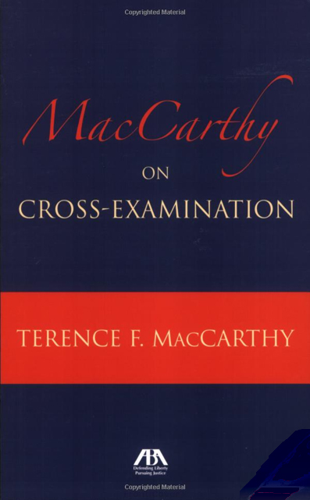

Slide 51
McCarthy cross
Look good
Tell a story
Use short statements

Slide 52
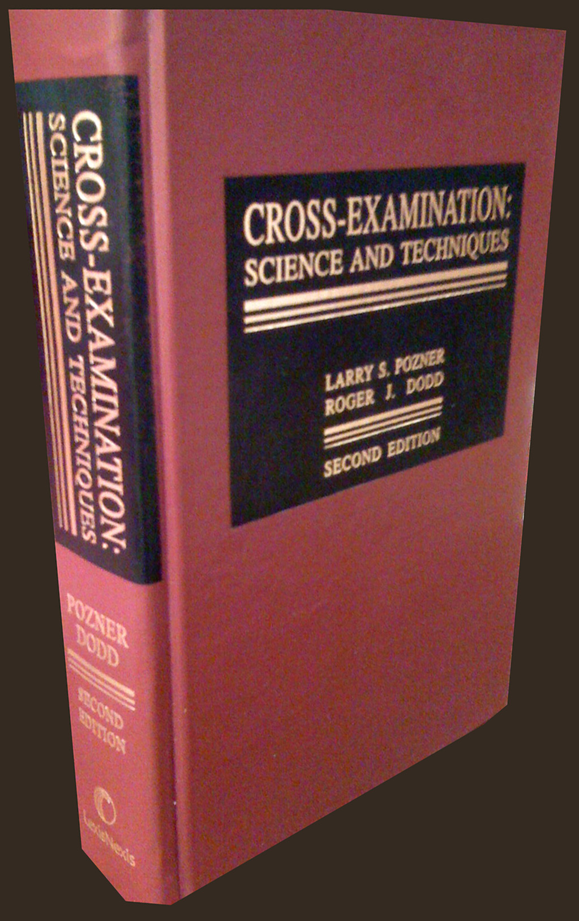

Slide 53
Basics for cross
Leading
One new fact per question
General to specific
Chapter method
Avoid bait
Cut off safe havens
Looping
Pozner and Dodd, Cross-Examination: Science and Techniques (2nd.Ed. LexisNexis)

Slide 54
Unresponsive witness
Ask, repeat, repeat
Reversal or ask, repeat, reverse
Full formal name
Sir or ma’am
Shorten the question

Slide 55
Unresponsive witness
Polite interruption
The hand
The shaken finger
Head shake
The seat
Objection: non-responsive answer

Slide 56
Unresponsive witness
The court reporter
Use of a blackboard
Poster
“That didn’t answer my question did it”
“My question was . . .”
“Then your answer is yes”

Slide 57
Unresponsive witness
“If the truthful answer is yes, will you say yes?”
Story times three
Elimination
Spontaneous loops

Slide 58
Prior inconsistent statements
“Uncover or find the inconsistency;
Physically prepare the cross-examination on impeachment;
Establish the current version of the fact to be impeached;
Tie the witness to the current version of the fact to be impeached - “and you are as certain of this fact as you are of every other fact in this case?”

Slide 59
Prior inconsistent statements
Equate or translate the versions;
Expose the inconsistent statement;
Maximize the damage or effect; and
Listen for useful volunteered information at trial.”
Pozner and Dodd, Cross-Examination: Science and Techniques (2nd.Ed. LexisNexis)

Slide 60
Federal Rules of Evidence, Rule 803(18)
(18) Learned treatises. To the extent called to the attention of an expert witness upon cross-examination or relied upon by the expert witness in direct examination, statements contained in published treatises, periodicals, or pamphlets on a subject of history, medicine, or other science or art, established as a reliable authority by the testimony or admission of the witness or by other expert testimony or by judicial notice. If admitted, the statements may be read into evidence but may not be received as exhibits.

Slide 63
Police report
“The first test administered was the Horizontal Gaze Nystagmus. I observed six of six clues. Defendant’s left and right eyes lacked smooth pursuit. His left and right eyes also displayed distinct and sustained nystagmus at maximum deviation, and displayed nystagmus onset prior to 45 degrees.”

Slide 65
NHTSA’s standardized field sobriety tests
The National Highway Traffic Administration (NHTSA) developed tests?
They are standardized?
That means they are supposed to be administered the exact same way every time?
And interpreted the same way?
By every officer in the country?
In order to help you decide who to arrest and who to let go for drunk driving?

Slide 66
NHTSA’s standardized field sobriety tests
You testified that you were trained in the administration of standardized field sobriety tests?
You were certified in the administration of SFSTs?
You were trained with a manual?
You were trained with the (year) manual?
The manual is a reliable authority for how the tests should be done?
And you were trained that the tests must be administered in the prescribed standardized manner or they are invalid? (NHSTA student manual VIII-19)

Slide 67
Horizontal Gaze Nystagmus – Proper Administration
There are 3 standardized field sobriety tests approved by NHTSA?
They are the horizontal gaze nystagmus or HGN, walk and turn, and one leg stand?
The first test is HGN?
Nystagmus is an involuntary jerking of the eye?
Notes:
67

Slide 68
Horizontal Gaze Nystagmus – Proper Administration
You were trained how to administer HGN?
In fact, you have been certified by this court as an expert in the administration of HGN?
You administered the HGN test correctly in this case?
You administered the HGN test the same way you always do it?
You are sure of that?
Notes:
68

Slide 69
Horizontal Gaze Nystagmus – Proper Administration
First you “have the subject remove glasses if worn”? (NHTSA student manual VIII-6)
You ask if they are wearing contacts?
You must place the stimulus in the proper position?
That is approximately 12"-15" from nose, just slightly above eye level?
You say, “I am going to check your eyes”
Notes:
69

Slide 70
Horizontal Gaze Nystagmus – Proper Administration
Then you say "Keep your head still and follow this stimulus with your eyes only”?
Next you say "Keep following the stimulus with your eyes until I tell you to stop”?
First you check for equal pupil size and resting nystagmus?
Notes:
70

Slide 71
Horizontal Gaze Nystagmus – Proper Administration
Next you check for equal tracking?
You move the stimulus across the subject’s entire field of vision to see if the eyes track together?
You move it both ways?
So checking for equal tracking requires a minimum of 2 passes?
Notes:
71

Slide 72
Horizontal Gaze Nystagmus – Proper Administration
Then you check for lack of smooth pursuit? (NHTSA student manual VIII-7)
When checking for lack of smooth pursuit it should be a smooth movement from center of nose to maximum deviation in approximately 2 seconds and then back across subject's face to maximum deviation in right eye, then back to center?
First you check the left eye?
Then you check the right eye?
Then you repeat?
So checking for lack of smooth pursuit takes 4 passes?
Notes:
72

Slide 73
Horizontal Gaze Nystagmus – Proper Administration
After checking for lack of smooth pursuit you check for distinct and sustained nystagmus at maximum deviation?
To do this you move the stimulus to maximum deviation (no white showing)?
The stimulus must be held there for a minimum of 4 seconds?
You check the left eye, then the right eye?
Then you repeat?
So checking for distinct and sustained nystagmus takes 4 passes?
Notes:
73

Slide 74
Horizontal Gaze Nystagmus – Proper Administration
After checking for distinct and sustained nystagmus at maximum deviation you check for onset of nystagmus prior to 45 degrees?
You move the stimulus slowly, taking approximately 4 seconds from center to 45 angle?
If you see nystagmus you hold for 4 seconds?
Notes:
74

Slide 75
Horizontal Gaze Nystagmus – Proper Administration
You check the left eye and then the right eye?
Then you repeat?
So checking for onset of nystagmus prior to 45 degrees takes 4 passes?
Then you do 2 vertical passes to check for vertical nystagmus?
Notes:
75

Slide 76
Horizontal Gaze Nystagmus – Proper Administration
So you have 2 passes to check for equal tracking?
And 4 passes to check for lack of smooth pursuit?
Another 4 passes to check for distinct and sustained nystagmus at maximum deviation?
And 4 passes to check for onset of nystagmus prior to 45 degrees?
Notes:
76

Slide 77
Horizontal Gaze Nystagmus – Proper Administration
So when you add the number of horizontal passes the total number is 14?
Notes:
77

Slide 78
This case
In this case you testified you observed 6 out of 6 clues for HGN?
And your report indicates you observed 6 out of 6 clues for HGN?
That means you observed equal tracking?
Lack of smooth pursuit?
Distinct and sustained nystagmus at maximum deviation?
And onset of nystagmus prior to 45 degrees?
And it took 14 passes to complete the test?

Slide 79
This case
Your car has a video camera?
The video camera was working when you arrested my client?
The video fairly and accurately depicts your administration of HGN to my client on the night of his arrest?
Show the tape.

Slide 81
This case
According to the tape, you only did 4 passes?

Slide 84
One leg stand

Slide 85
One leg stand

Slide 86
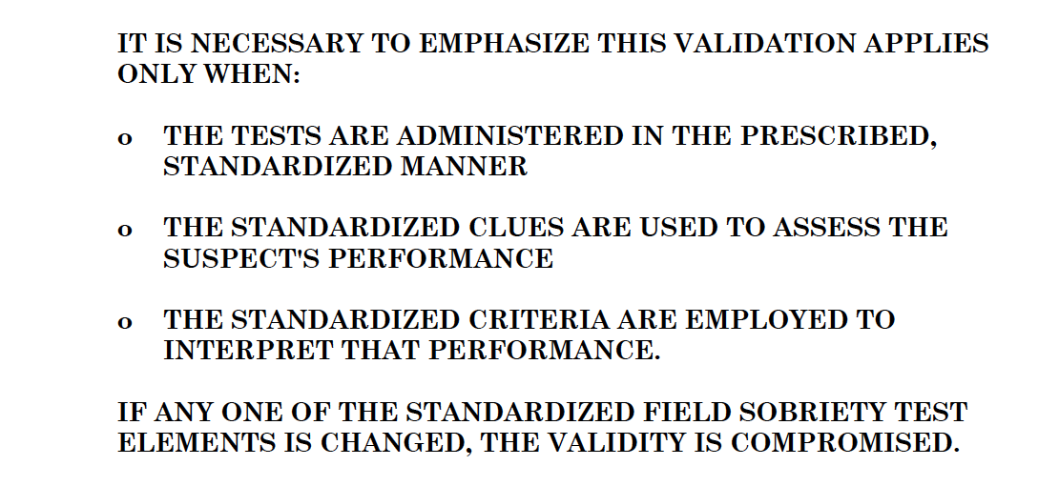

Slide 87
The end!

